Slide 1
Agency Liaison Program Training
Increasing SDB/SB Participation in Commonwealth Procurement
October 31, 2017

Slide 2
Bureau of Diversity, Inclusion and Small Business Opportunities (BDISBO)
MISSION: Support the growth and development of small businesses (SBs) and small diverse businesses (SDBs)
VISION: To increase Commonwealth SB/SDB spend and create a more welcoming and conscientious SB/SDB procurement culture throughout all commonwealth agencies.

Slide 3
Agenda
Welcome/Introductions
BDISBO Organization
Governor’s Priorities and Agenda
The Problem We Need To Solve
What We Are Asking You To Do
Jaggaer System Update– Increase Utilization of RFPs
Small Business Programs & Reporting
Questions and Answers

Slide 4
BDISBO Organization
Deputy Secretary for Diversity, Inclusion & Small Business Opportunities
Kerry L. Kirkland
Director of the Bureau of Diversity, Inclusion & Small Business Opportunities
DeShawn Lewis
Certification Unit
Cassandra Nevel
Procurement Compliance Unit
Curtis Burwell
Construction Compliance Unit
VACANT
Administrative Officer 3
Chi-Chi Owunwanne
Administrative Officer 2
Tina Marks
Ferzana Irani
VACANT
Beth Nonemaker
Kheea Anderson
Business Enterprise Analyst
Vince Adigwu
Procurement Liaison
Audrey Smith
Construction Liaison
Paula Murphy

Slide 5
BDISBO Customers?
Vendor Community
Small Businesses
Small Diverse Businesses
Large Businesses
Agency Staff
Public
Other Business Entities
Legislature
Governor’s Office

Slide 6
BDISBO Services
Scoring of SB/SDB Submittals, a portion of Request For Proposal (RFP) responses
Procurement
Construction/Design
Training/Technical Assistance
Self-Certification & Verification for SBs/SDBs
Locate SBs and SDBs in online database
Assist with locating procurement opportunities
Strategize utilization for SBs/SDBs
Participate in Supplier Forums
Provide appropriate SB/SDB language
Compliance: Monitor percentage commitments made as contractual agreements by prime contractors for the utilization of SB/SDBs on commonwealth contracts. Collaborate with Agency for Resolution.

Slide 7
Executive Order 2015-11
Promotes Diversity, Inclusion and Small Business Opportunities
Issued September 23, 2015
Recognize the need for better Agency Coordination
Place continuous focus on increasing SB/SDB spend
Established an Governor’s Advisory Council
Led by four agency heads: DGS, L&I, DCED & Transportation
Provide SB/SDB advise to Governors Office/Executive Agencies
Developed SDB program improvement recommendations
Created Bureau of Diversity, Inclusion and SB Opportunities
Formally Bur. of Small Business Opportunities
Singular focus on diversity and inclusion & SB Opportunities

Slide 8
The Problem We Need to Solve…
Goal by FY’19

Slide 9
The Problem We Need to Solve…
For comparison, Maryland’s SB/SDB expenditures exceed $2.5 Billion
Pennsylvania has historically applied our SB/SDB program to just one out of every four dollars we spend
DGS recently awarded a contract to conduct a formal disparity study to support a more comprehensive program statewide
Results available in 12 months
Basis for applying DISBO universally
In the meantime, we need your help…

Slide 10
The Solution We Are Proposing
Governor to make more frequent public appearances addressing the need for greater diversity and inclusion
Agency heads to be personally involved in communicating this priority within their agencies
Change hearts and minds
Appoint senior-level Liaisons in each agency
Require Liaison to be involved in planning for every new agency contract
DGS to train Agency Liaisons and provide assistance with:
Increased use of new RFP/Best Value procurement methods
Agency-level SB/SDB goal setting
Integrating SB/SDB goals with Agency Program and Procurement goals
Re-invigorating the SB set-aside program
Routine reporting requirements

Slide 11
Agency SB/SDB Liaison Program
Senior-level Agency Liaisons appointed July 1.
Key component of comprehensive strategy to increase commonwealth SB/SDB spend
Provides a mechanism to develop and maintain consistent communication and collaboration between Commonwealth Agencies and BDISBO
Create a reporting and goal setting structure that requires Agencies to report SB/SDB spend data
September 11, Senior-level Agency Liaisons meeting introducing the liaison program

Slide 12
Why Are You Here?
Governor’s Advocates for Diversity and Inclusion
Drive Agency Strategy to Increase SB/SDB Spend
Establish Process to Insure Agency Liaison Involvement w/ all Agency Procurements
Monitor Procurement Pipeline for SB/SDB Opportunities

Slide 13
What We Are Asking You To Do
Utilize BDISBO’s Agency Procurement Monitoring Tools/Staff
Access Agency Procurement Forecast for SB/SDB Opportunities
Diversify Agency RFP Evaluation Committee
Insure Customer Friendly Agency Contracting Environment
Develop Agency SDB Outreach Strategy (workshops/seminars)
Integrate Diversity and Inclusion into the Agency’s Strategic Plan
Increase Volume of RFP Procurements (Jaggaer)

Slide 14
Jaggaer Update

Slide 15
What is Jaggaer?
Derivative of the German word for “hunter”
SOURCING DIRECTOR: STRATEGIC SOURCING SOFTWARE
Sourcing Director helps you create events, manage bids, and award contracts automatically.
An intuitive wizard-driven interface
Configurable workflows, RFx templates, and content libraries
We will use it for RFP’s, RFQ’s, and RFI’s
Self-service access for suppliers
TOTAL SUPPLIER MANAGER: VENDOR MANAGEMENT SOFTWARE
TSM automates supplier management from discovery and information gathering through registration, qualification, and selection.
Web-based, centralized repository
New ITQ Portal and pre-qualification process
Automated communications and supplier self-service on-boarding

Slide 16
Jaggaer Update
ITQ/RFQ training is in process – 152 trained to date
RFP Training will begin in November – 79 scheduled to attend, but more are scheduling each day. Training dates are 11/8, 11/9, 11/14, 11/15, and 11/16 with more to be scheduled in December
RFQ and RFP templates in Jaggaer
5 RFP’s and 12 RFQ’s published in Jaggaer to date
Over 200 COPA users are set up in Jaggaer
5,860 COPA suppliers in Jaggaer – 3,729 are small/small diverse businesses
Note: We did not wait to pilot only in DGS before rolling out to agencies, so user feedback to DGS team is important. The tool is configurable, so we can make changes as needed.

Slide 17
BDISBO Small Business Programs

Slide 18
Small Business Self-Certification Requirements
For profit United States business
Independently owned
Not dominant in its field of operation
No more than 100 Full-Time Equivalent (FTE) employees
Earns no more than a maximum 3-year Average Gross Sales depending on Business Type
$7 Million | $20 Million | $25 Million
Building Design Services | Procurement Goods Procurement Services Construction Contractor & Supplier | Information Technology Goods & Services
2-year renewal

Slide 19
Small Diverse Business Requirements
Verification of Minority (MBE), Woman (WBE), Veteran (VBE), Service Disable Veteran (SDVE), LGBT (LGBTBE), Disability-Owned (DOBE) Business Enterprise
Self-certified Small Business with the Small Business Contracting Program
At least 51% minority, women, veteran, service-disabled veteran, LGBT, or Disabled owned and controlled.
Certification through at least one of the following approved third parties:
Woman’s Business Enterprise National Council
National Minority Supplier Development Council
Unified Certification Program
U.S. Small Business Administration 8(a) Business Development
U.S. Department of Veterans Affairs Vets First Verification Program
U.S. Business Leader’s Network DOBE/SDVE
National Gay & Lesbian Chamber of Commerce
2-year renewal

Slide 20
Small Business Programs
Small Business Reserve Program
Prime contracting program
Participating agencies under Governors jurisdiction. Others encouraged to participate
Race and gender neutral
Must meet “small business” requirements
Online self-certification process through PASupplierPortal
Small Diverse Business Program
Subcontracting program
Goal: 10% FY17, 20% FY18, 30% FY 19
Participating agencies under Governors jurisdictions. Others encouraged to participate
Race and gender specific
Includes DGS, SBs and verified SDBs
Certification required from DGS Approved Third Party Entity for SDBs
Verified SDBs & Self-certified SBs can also perform as prime contractors
Notes:
BDISBO SMALL BUSINESS PROGRAM(S) / Goal and Objectives

Slide 21
Small Business Program Enhancements
E-marketplace
Advertising
Auto populate Small Reserve Std. language
SRM PO
Small Business Indicator
Comptroller Review/Approval
Small Business Indicator
Small or Small Diverse Business Certificate
Small Reserve Language included in PO
Small Business Owner Communication
Agencies forward to current small business partners
DGS Small and Small Diverse status – 2 year renewal

Slide 22
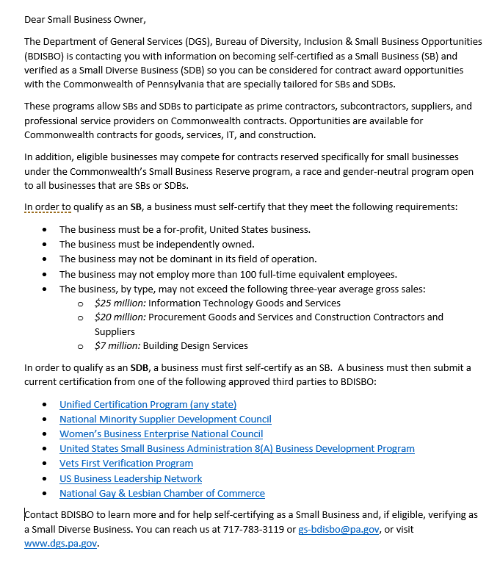
Small Business Communication for DGS Self Certification / Verification

Slide 23
Procurement Preferences
Unique Source: Blind and Handicapped
Correctional Industries
Small Business Reserve Program: Search BDISBO’s database for pool of vendors www.smallbusiness.pa.gov

Slide 24
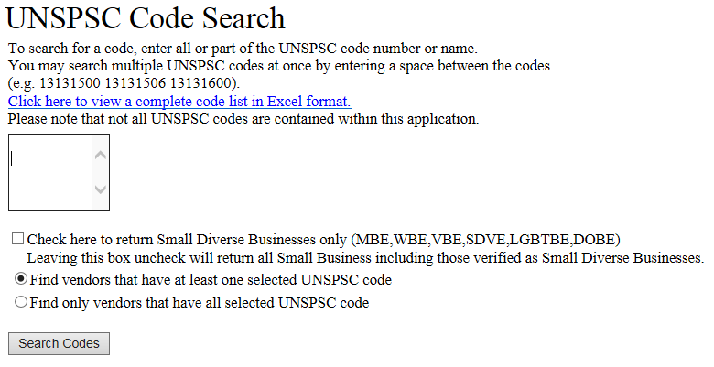
Finding Small Businesses
www.dgs.pa.gov > Businesses > Small Diverse Business Program > Locate Small and Small Diverse Businesses > www.dgs.internet.state.pa.us/SBPI/AlphaResults.aspx > Search By: UNSPSC Code
Find Codes
Enter Codes

Slide 25
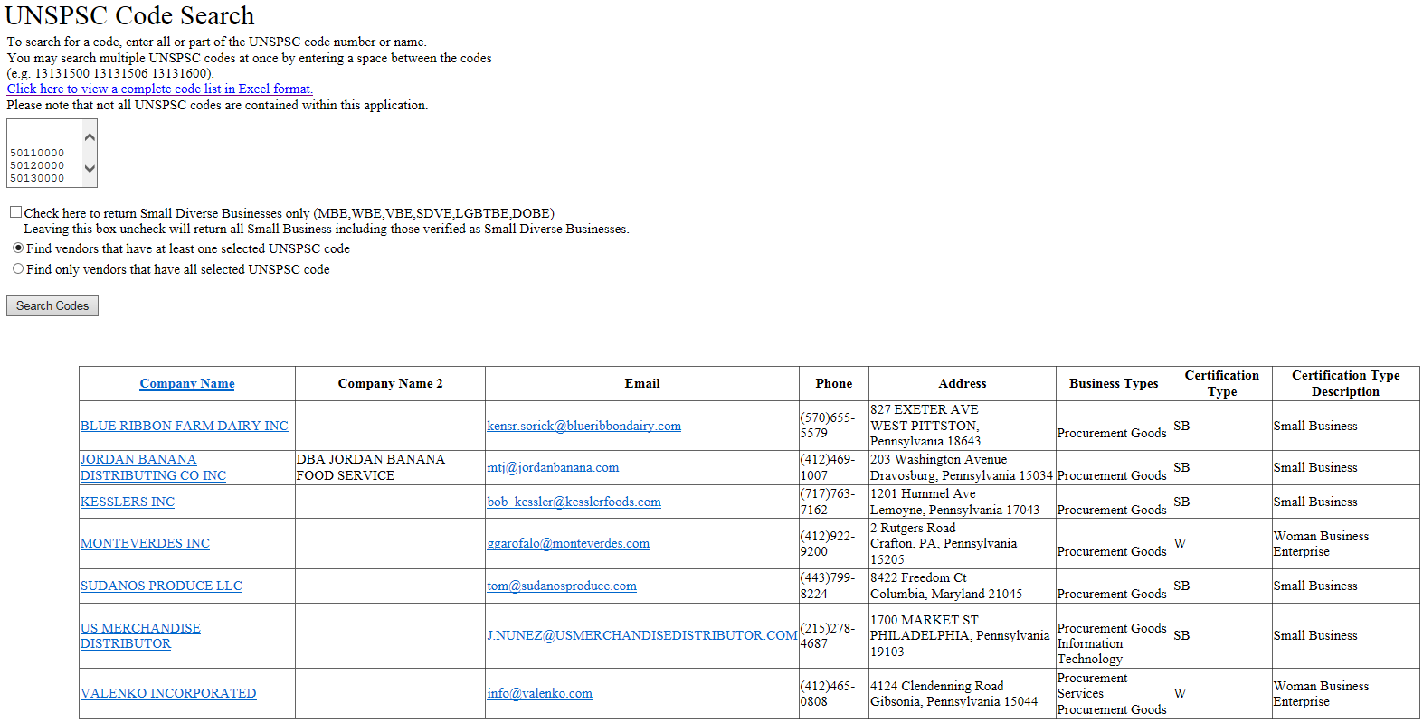
Finding Small Businesses

Slide 26
BDISBO Tools/Report
Small and Small Diverse Business Spend Report
Business Warehouse Report
Captures Small Reserve Info.
Captures SB and SDB prime spend
Agency Award / Solicitation Report
Captures Award Information
Captures Solicitation Information
Submit to BDISBO
Agency Procurement Forecast Report
Forecasts Agency Procurements 6 – 12 Months in Advance
Submit to BDISBO
BDISBO’s Intranet Site
Agency Folder Specific
Monitoring Tool
Reports due the 5th of every month

Slide 27
Small & Diverse Spend Report
Business Warehouse
Reports on procurement, IT, and construction payments made by agencies to Small Diverse Businesses and Small Businesses. The payments are associated with specific Commitment Items identified by BDISBO.

Slide 28
Small & Diverse Spend Report
Prerequisites
Know your 6-digit Employee ID Number.
Obtain: *
SAP logon account
A BW login account with username and password
SAP roles authorization (Procurement role)
*This is generally done through your agency Human Resources.

Slide 29
Small & Diverse Spend Report
Go to Business Warehouse
Roles > Procurement Reporting > Global Spend > Small Diverse Spend by Business Area
Enter the 2-digit month and 4-digit year
Enter the business area
Notes:
START icon > All Programs > Business Explorer > Analyzer > (Microsoft Ofc. Excel Security Notice > Enable Macros)
Empty Excel page appears
Add-Ins > BEx Analysis Toolbox: Open (open folder) icon > Open Workbook…
SAP Logon > Client: 110; User: P00[6-digit Emp. ID); Language: EN > OK

Slide 30
Small & Diverse Spend Report
With Identified Commitment Items (CI) Hierarchy summary sheet
Summary of the Prime Small Diverse Business and Small Business spend for each business area.
Spend will appear only for the business area on which the report was run (all other business areas will be $0).
Provides a percentage for each designation of spend.
Tool For Agency Prime Spend
Net Postings | Total payments associated with identified Commitment Items posted to the agency during the report period.
SDB Spend | Portion of the Net Postings paid to vendors with active Small Diverse Business (SDB) verifications at the time of payment
SB Spend | Portion of the Net Postings paid to vendors with active Small Businesses (SB) certifications at the time of payment. SB Spend payments may overlap with Small Reserve if the payment is made on a contract reserved for Small Business. SB also includes SDB Spend.
Small Reserved | Portion of the Net Postings paid on contracts that were reserved for Small Businesses. Small Reserve payments may overlap with SB Spend if a vendor has an active SB certification at the time of payment.
Notes:
With CI Hierarchy tab/worksheet < SUMMARY
Net Postings: Total payments associated with identified Commitment Items posted to the agency during the report period.
SDB Spend: Portion of the Net Postings paid to vendors with active Small Diverse Business (SDB) verifications at the time of payment
SB Spend: Portion of the Net Postings paid to vendors with active Small Businesses (SB) certifications at the time of payment. SB Spend payments may overlap with Small Reserve if the payment is made on a contract reserved for Small Business. SB also includes SDB Spend.
Small Reserved: Portion of the Net Postings paid on contracts that were reserved for Small Businesses. Small Reserve payments may overlap with SB Spend if a vendor has an active SB certification at the time of payment.

Slide 31
Small & Diverse Spend Report
Small & Small Diverse Business Spend sheet
Feeds into the With CI Hierarchy summary table
Swap out Business Area for Vendor to view payments to individual vendors
Right click in any cell of the Business Area column > Swap Business Area With > Vendor
Notes:
Small & Diverse Spend tab/worksheet < DATA
Posting Date: date pmt posted
SDB Start/End: Validity dates for the SDB (begin and end dates that vendor recognized as SDB); End = Expiration
SB Start/End: Validity dates for the SB (begin and end dates that vendor recognized as SB); End = Expiration
Amount w/ CI Hierarchy: Value associated with tracked Commitment Item
SDB Valid On w/ CI Hierarchy: Pmts made during period vendor recognized as SDB (current/valid SDB verification)
SB Valid On w/ CI Hierarchy: Pmts made during period vendor recognized as SB (current/valid SB cert)
Small Reserved w/ CI Hier: Pmt made on SBR contract

Slide 32
Monthly Contract Award Report
Reports on agency-specific solicitations and awards over the course of a fiscal year.
Submitted to the BDISBO every month for Small Business and Small Diverse Business monitoring and compliance.
Find the report at www.dgs.pa.gov > Businesses > Small Diverse Business Program > Small and Small Diverse Business forms, Annual Reports, and other resources

Slide 33
Monthly Contract Award Report
Data Entry
Records solicitations and awards made by the agency each month over the course of a fiscal year. All solicitation data should be entered regardless of award status. Award information can be entered once an award is made.
Solicitation Document # Solicitation Type Solicitation Description | Award Document # Award Amount Award Date Award Document Award Term (Years)
Notes:
Solicitation Types
General Contract/Agreement
IFB - Invitation for Bid
ITQ - Invitation to Qualify
RFP - Request for Proposal
RFQ against ITQ
Small Reserve for SB
Sole Source
Award Documents
Funds Commitment
SAP Contract
SAP Purchase Order
Small Reserve PO
SRM Contract
SRM Purchase Order

Slide 34
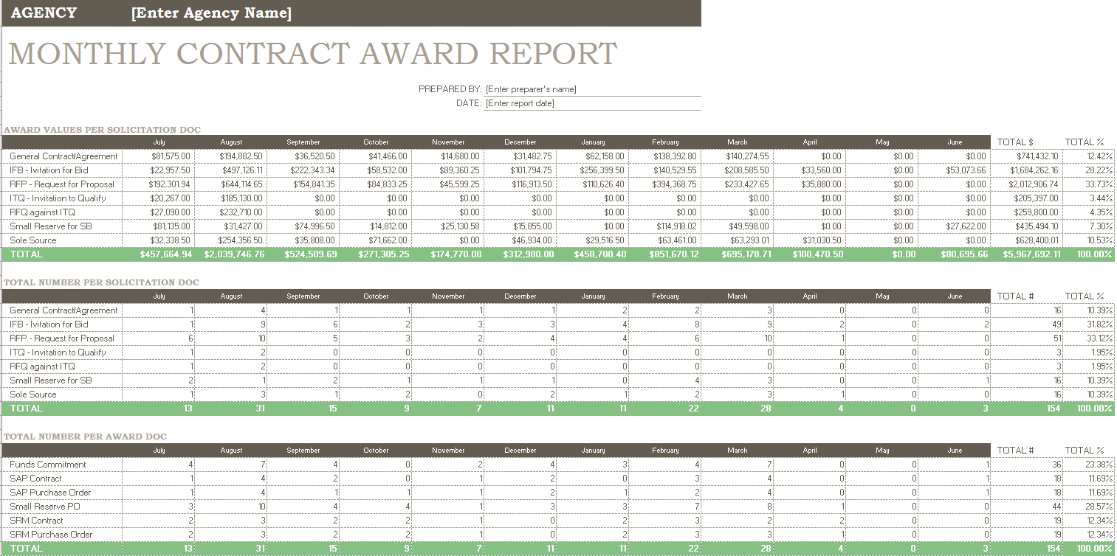
Monthly Contract Award Report
Agency Report
Summarizes solicitation and award information by month, solicitation type, award type, and award amount. Solicitations will not be tabulated until the award information for the solicitations has been entered.
Notes:
Award Values per Solicitation Doc & Total # Per Solicitation Doc
General Contract/Agreement
IFB - Invitation for Bid
RFP - Request for Proposal
ITQ - Invitation to Qualify
RFQ against ITQ
Small Reserve for SB
Sole Source
Total # Per Award Doc
Funds Commitment
SAP Contract
SAP Purchase Order
Small Reserve PO
SRM Contract
SRM Purchase Order

Slide 35
Agency Procurement Forecast Report
Forecasts agency procurements 6 – 12 months in advance to predict SB/SDB opportunities.
Agency: Enter the name of the agency
Issuing Office: Enter name of the issuing office
Solicitation Title: Enter the title of the solicitation
Description: Enter a brief description of the solicitation
Existing Contract #: Enter the existing contract number
Proposed Solicitation Date: Enter the proposed date that the solicitation will be released
Procurement Method: Enter the proposed method of procurement for the solicitation
Contract Amount: Enter the estimated amount of the solicitation
Agency Contact: Enter the name of the agency contact for the solicitation
Agency Email: Enter the email for the agency contact
Notes:
Agency: Enter the name of the agency
Issuing Office: Enter name of the issuing office
Solicitation Title: Enter the title of the solicitation
Description: Enter a brief description of the solicitation
Existing Contract #: Enter the existing contract number
Proposed Solicitation Date: Enter the proposed date that the solicitation will be released
Procurement Method: Enter the proposed method of procurement for the solicitation
Contract Amount: Enter the estimated amount of the solicitation
Agency Contact: Enter the name of the agency contact for the solicitation
Agency Email: Enter the email for the agency contact

Slide 36
Future FY 2017-18 Meeting Dates
Monday, December 11, 2017
10:00a.m. – 12:00p.m.
Monday, March 13, 2018
10:00a.m. – 12:00p.m.
Monday, June 11, 2018
10:00a.m. – 12:00p.m.

Slide 37
Q and A
Questions?

