Slide 1
Reserving a Rental Vehicle
As of October 1, 2012, Commonwealth business travelers should follow the process outlined in the following slides to reserve a rental vehicle from either the Commonwealth Garage or from any Enterprise neighborhood branch.
If you have any questions about this process, please contact your Automotive Liaison.
Notes:
To access the Ground Travel Worksheet to make a reservation, go to the following website: www.dgs.pa.gov.

Slide 2
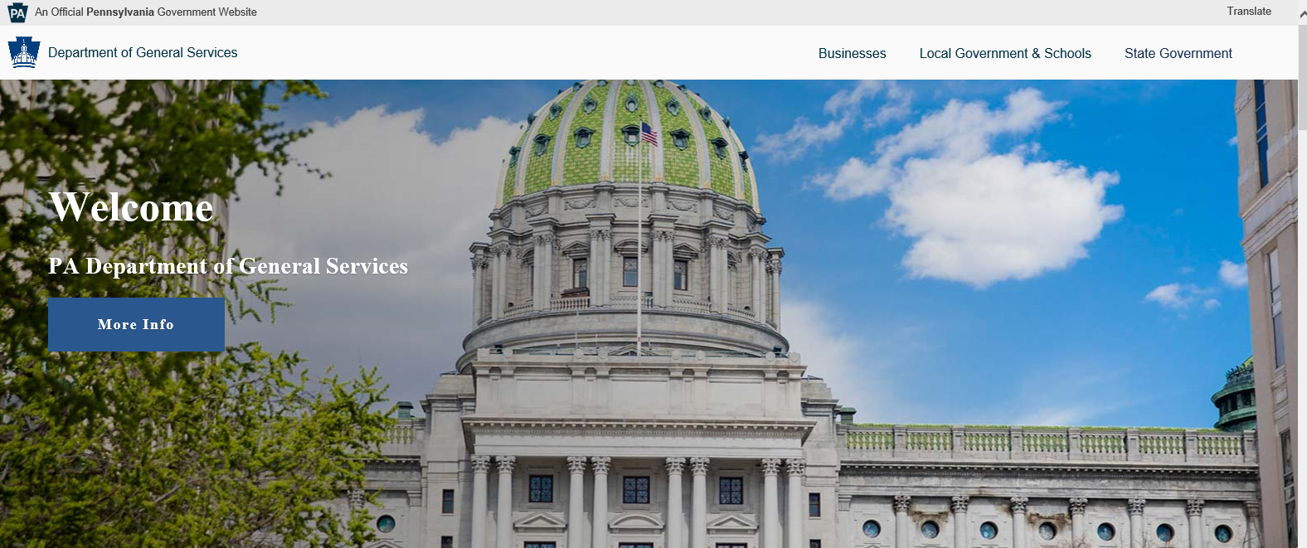
Notes:
Once on this page, hover over the heading of ‘State Government’ at the top right hand of the page. Then select Vehicle Management from the drop down menu.

Slide 3
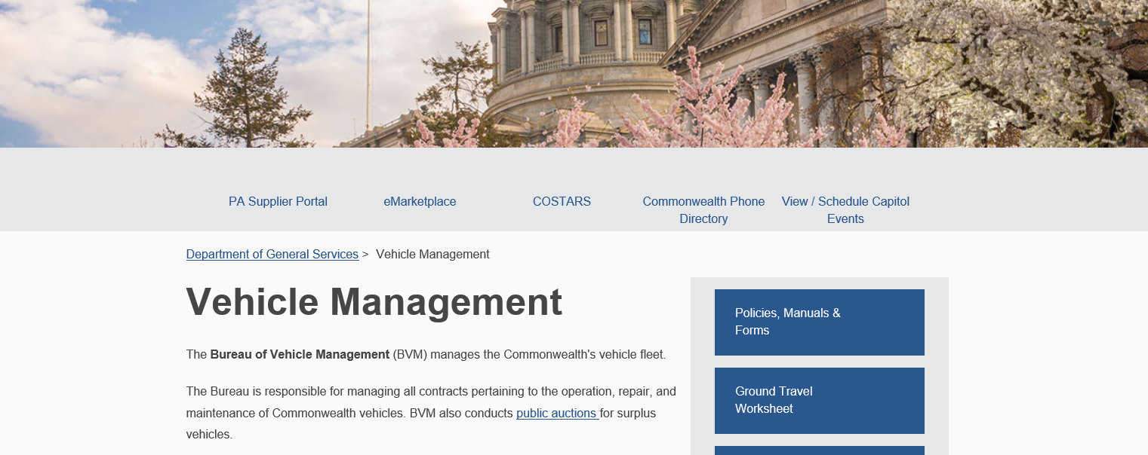
Notes:
Once on the Vehicle Management page, select Ground Travel Worksheet. You will then be directed to that section. Click on the underlined word Ground Travel Worksheet once more.

Slide 4
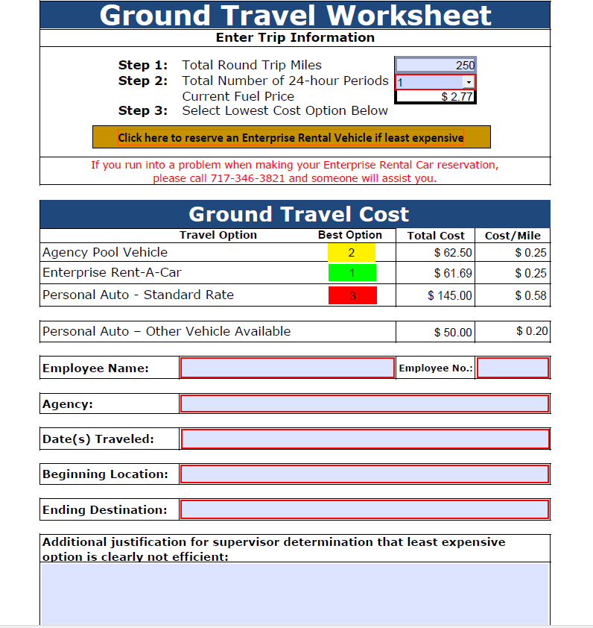
Notes:
Beginning October 1, 2012, Commonwealth business travelers will note a new feature on the Ground Travel Worksheet (located on the DGS website). If an Enterprise Rental Vehicle is determined to be the most cost effective ground travel option, travelers should click on the gold text bar to be directed to the Commonwealth’s custom reservation site.

Slide 5
Notes:
After selecting the gold text bar, travelers will be directed to this screen. If your car reservation is associated with an airline reservation, select “RESERVE A CAR ASSOCIATED WITH AIRFARE.” If your car reservation is NOT associated with airfare, select “RESERVE A CAR” as indicated by the red arrow.

Slide 6
Notes:
Rates are based on a 24 hour period. When reserving a vehicle you must enter the date and time that you will be picking up the vehicle. If you pickup the vehicle between 4:00 PM and 6:00 PM (Sun thru Th) and your business trip starts at 8:00 AM the next day, your charges will begin at 8:00 AM. If you pick up your vehicle on Friday or Saturday, you will be charged for those days. Remember, these vehicles are for official Commonwealth business use only and must not be used for personal travel.

Slide 7
Notes:
Select your agency. Please be advised that some agency names have changed and may now be listed as “Department of XX” or “PA XX”.

Slide 8
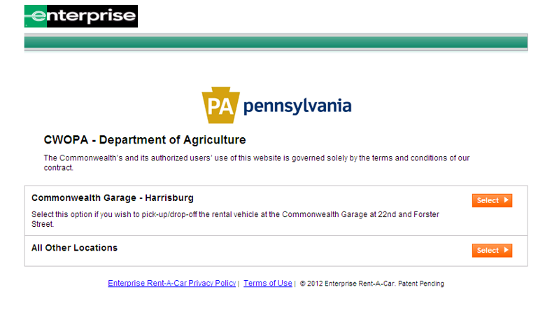
Notes:
Choose your pick-up location. If you select All Other Locations, simply type in the city and a list will show up on the next screen of all the locations in that immediate area.
DGS will provide an agency fuel card ONLY at the Commonwealth Garage in Harrisburg. At all other locations, a fuel card will NOT be provided. Commonwealth employees will have to submit for reimbursement.

Slide 9
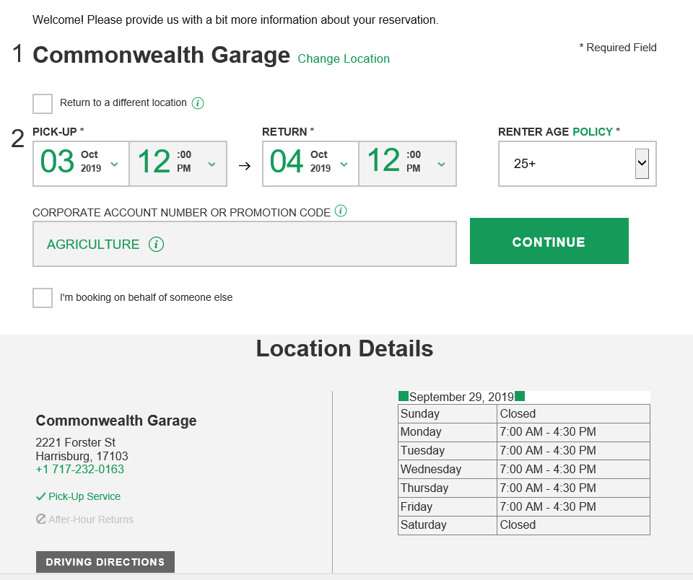
Notes:
Use this screen to enter the dates and times for your rental vehicle pick-up and drop off. This screen will also show the Hours of Operation of the location you selected. If you would like to pick-up at another location rather than the one showing, click on Change Location. Once finished, click on continue.

Slide 10
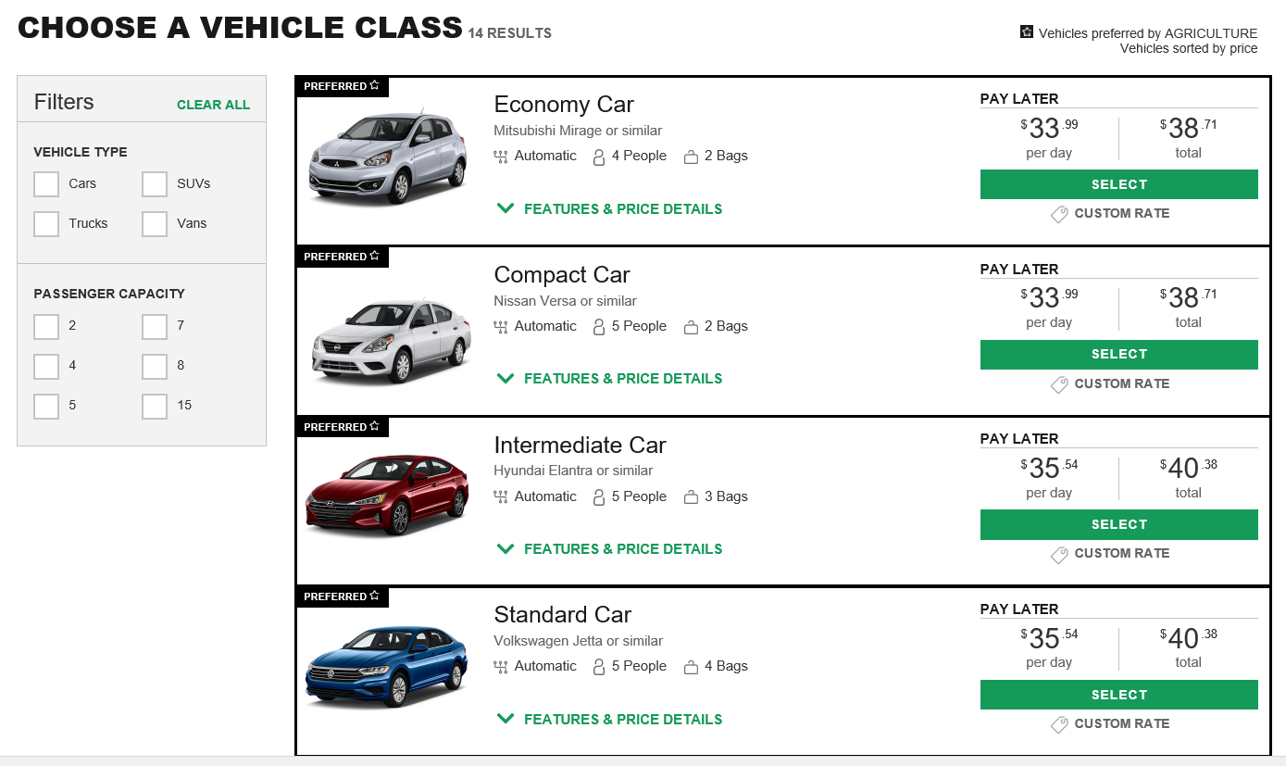
Notes:
Use this screen to select your vehicle. Economy, Compact. Intermediate, and Standard size vehicles are the vehicle classes compliant with the Commonwealth Travel Policy. Any vehicle type not listed as “preferred”, is NOT policy compliant without appropriate business justification from the traveler’s supervisor. All reservations for non-compliant vehicle types will be monitored and reported to your agency’s Automotive Liaison and Administrative Deputy Secretary. Accordingly, it is highly recommended that business travelers ensure appropriate permissions and justification for selecting a non-compliant vehicle PRIOR to making the reservation.

Slide 11
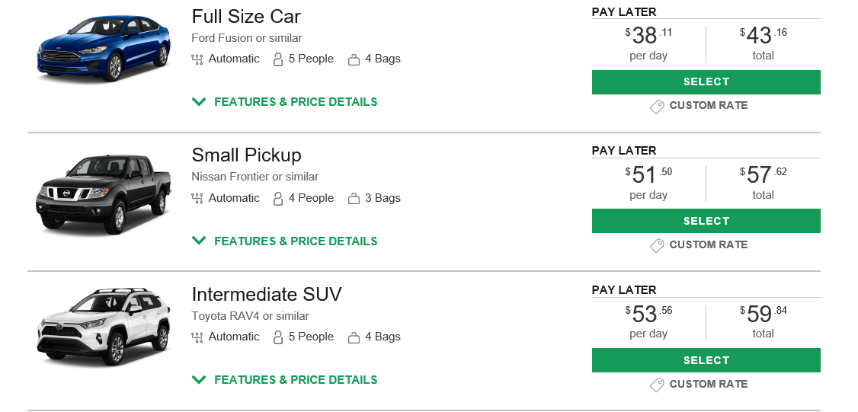
Notes:
Although not on the Preferred list, we do have these sizes available if needed and approved by management.

Slide 12
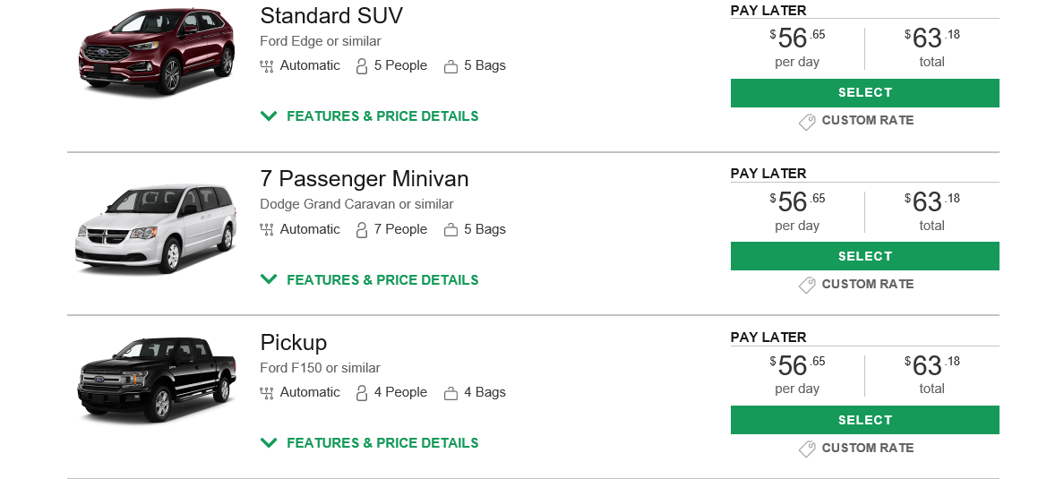
Notes:
Although not on the Preferred list, we do have these sizes available if needed and approved by management.

Slide 13
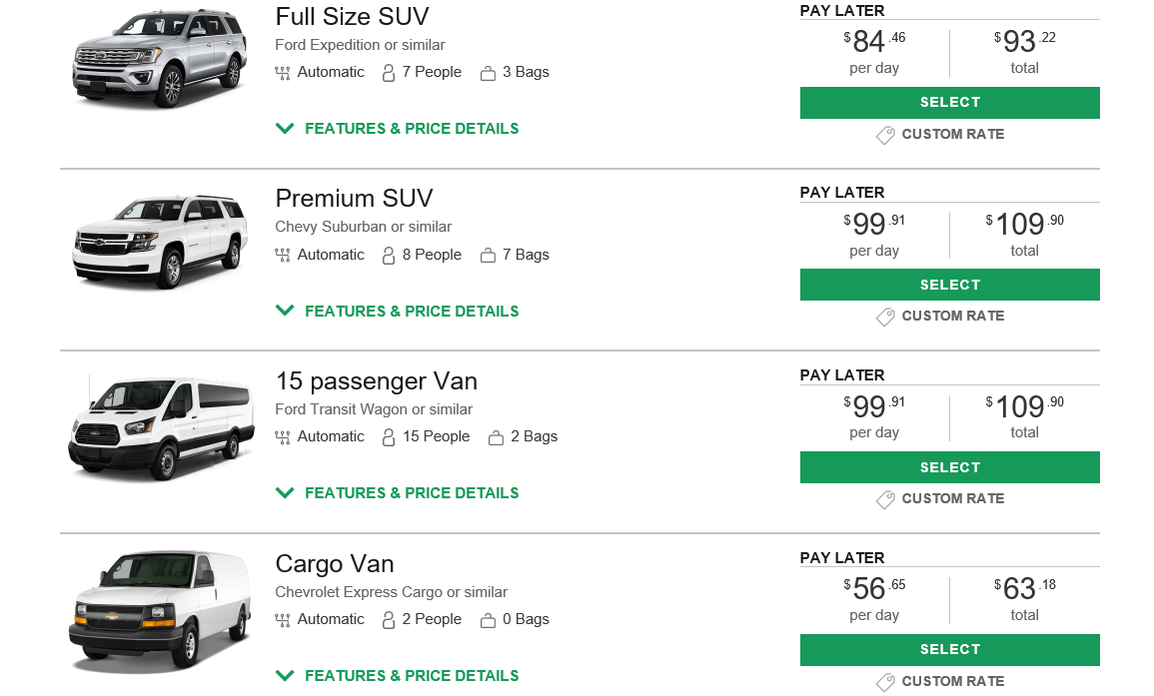
Notes:
Although not on the Preferred list, we do have these sizes available if needed and approved by management.

Slide 14
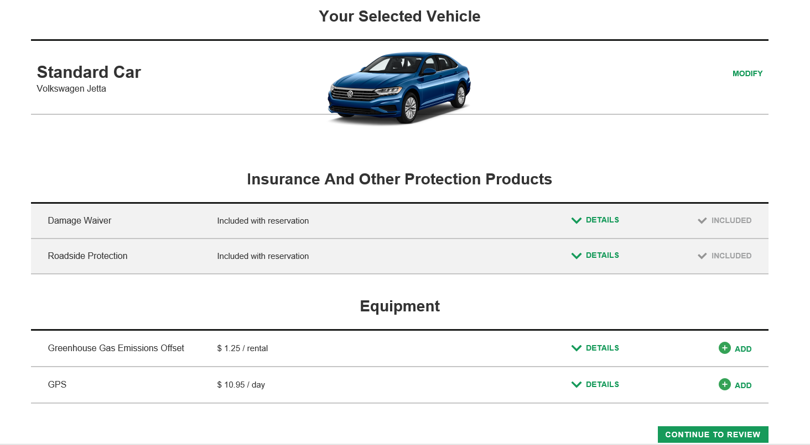
Notes:
Damage Waiver and Roadside Protection are included in your reservation. However, any additional equipment if chosen, will be at the sole financial responsibility of the renter. The Commonwealth will NOT cover these options. Once confirmed, click on Continue to Review.

Slide 15
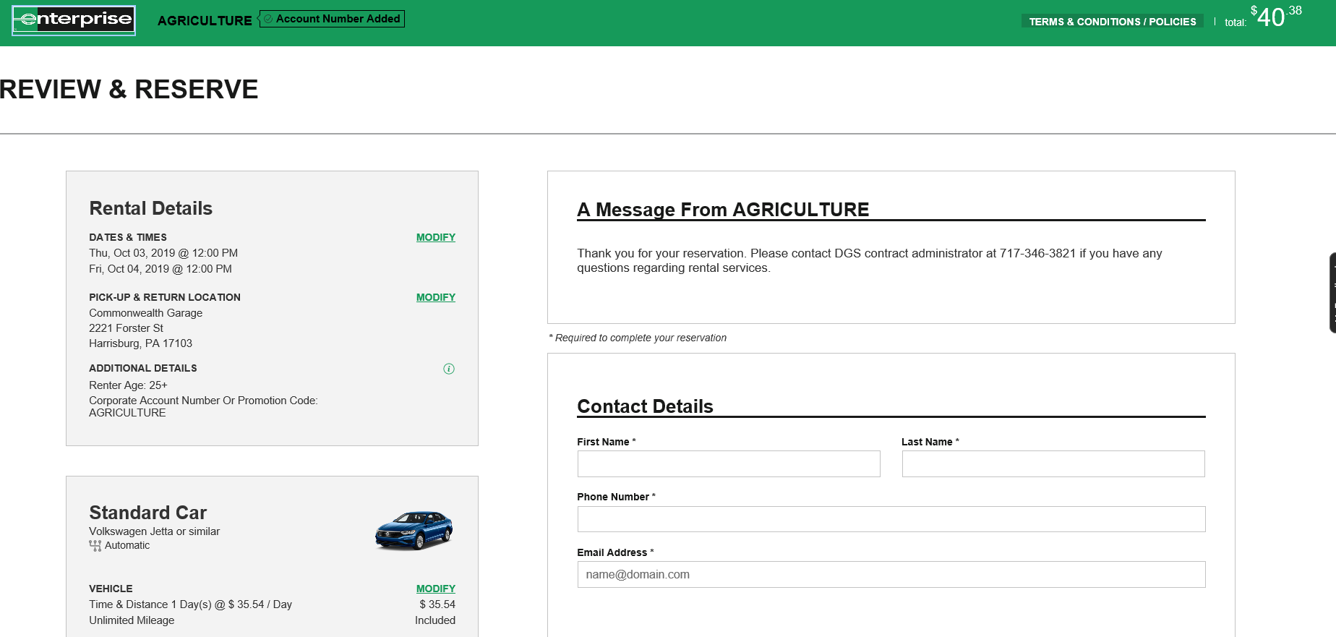
Notes:
Please provide your office or cell phone number in the event that Enterprise needs to contact you. Your email address is required to receive reservation confirmation.

Slide 16
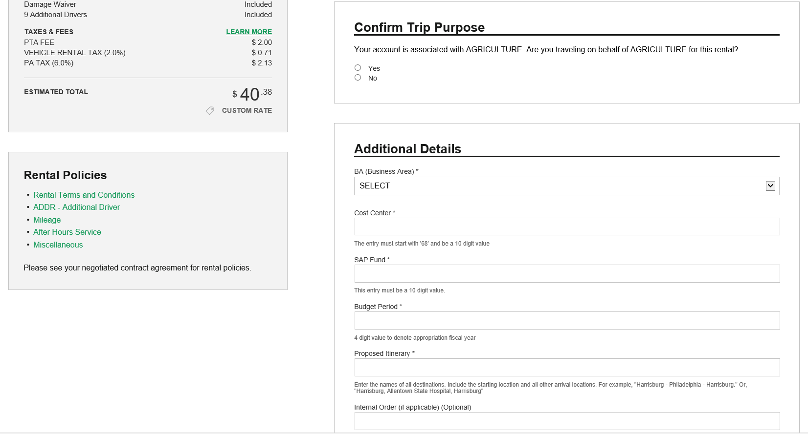
Notes:
All fields in the Additional Details section must be filled out as rentals will be billed directly to your agency based upon the Business Area, Cost Center, and SAP Fund information entered on this screen. Be sure to enter your proposed itinerary, including all points of travel. Please note, be sure to have the correct amount of digits or the reservation will not go through. See next slide for additional information.

Slide 17
Notes:
If required fields are missed, or if you do not have the correct amount of digits, you will receive an Error message like this.

Slide 18
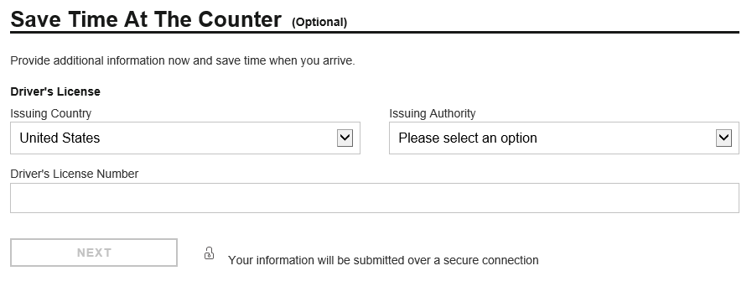
Notes:
While not required, travelers are strongly encouraged to enter the additional information when making the reservation. This may reduce your time at the rental counter when you arrive for pick-up.

Slide 19
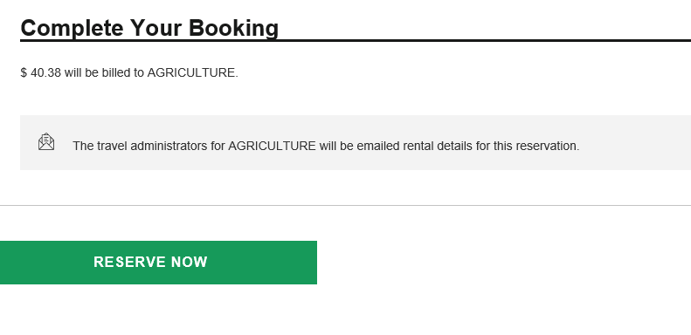
Notes:
Once you verify the accuracy of the information you entered, click on Reserve Now.

Slide 20
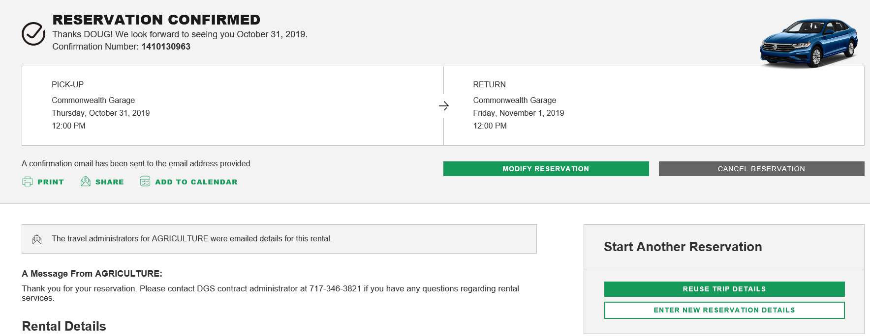
Notes:
After clicking on Reserve Now, you will get a screen with the confirmation number on it, as well as the option to cancel or modify.

Slide 21
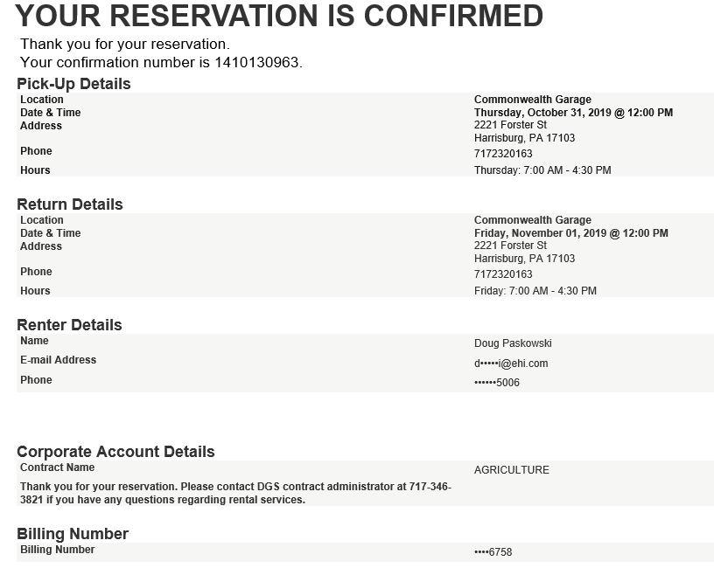
Notes:
This is an example of the email confirmation you will receive once you complete your booking.

Slide 22
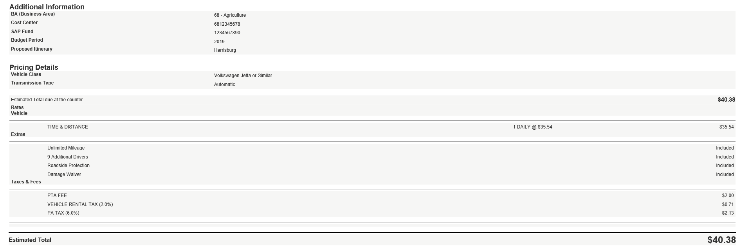
Notes:
Email Confirmation continued.

Slide 23
Notes:
Email Confirmation continued.

Slide 24
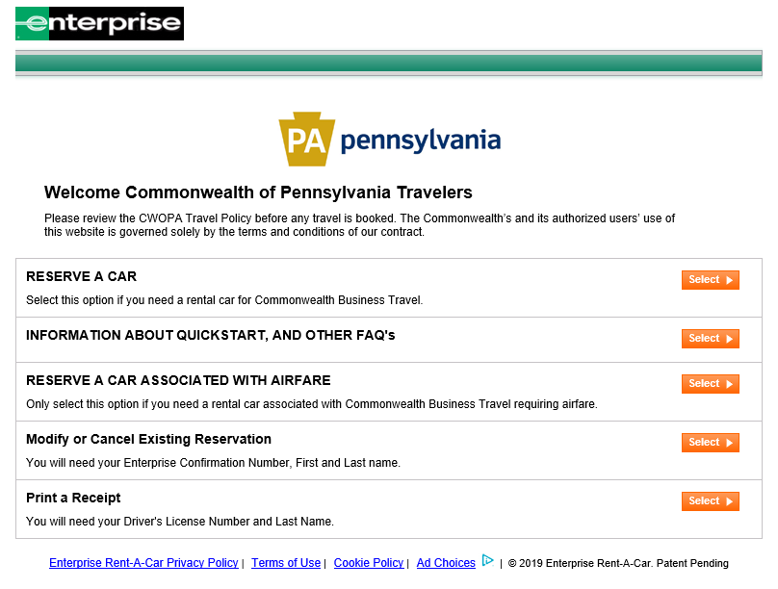
Notes:
If changes need to be made to the reservation such as day, time, or vehicle, go to this main screen and select Modify or Cancel Existing Reservation.

Slide 25
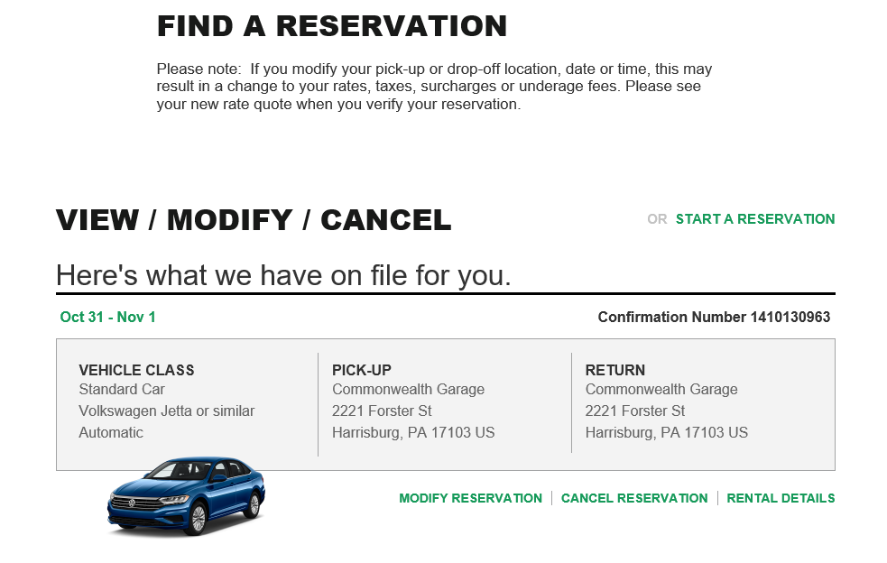
Notes:
Click on Modify Reservation

Slide 26
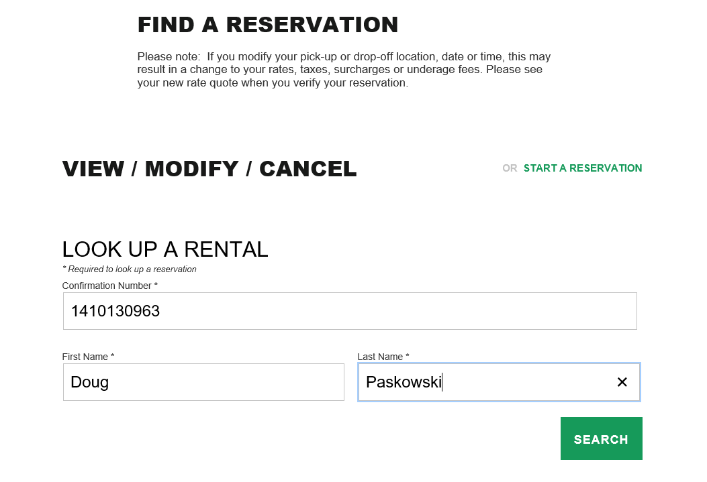
Notes:
Enter your name and confirmation number to access your reservation. Please note – all three fields MUST be filled out in order to access your reservation. Once complete, click on Search.

Slide 27
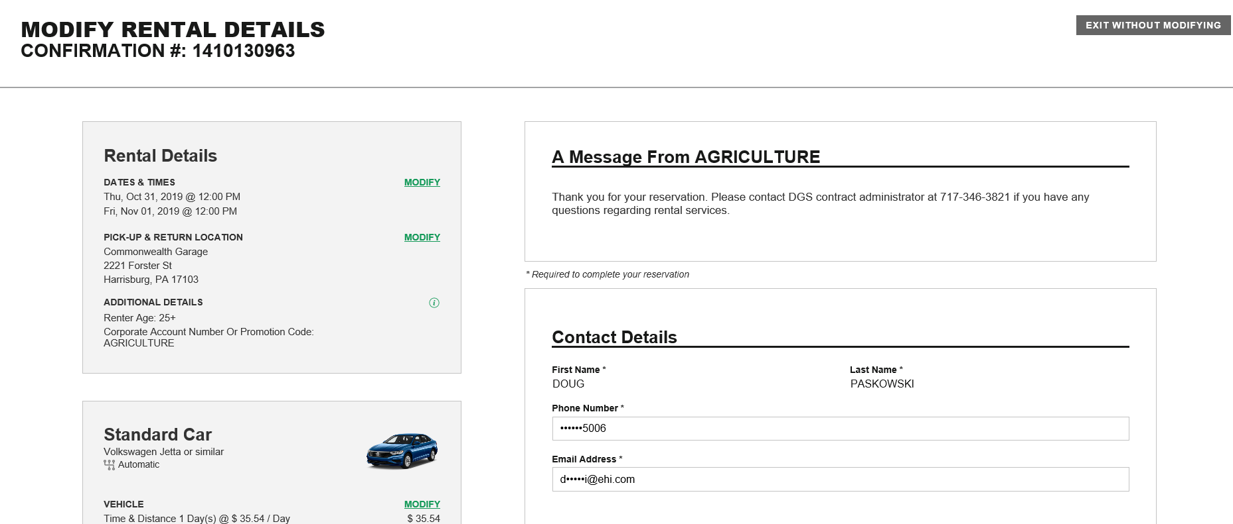
Notes:
Changes can be made by clicking on the green Modify words. In this example, the pick up time was changed to 3:00 PM.

Slide 28
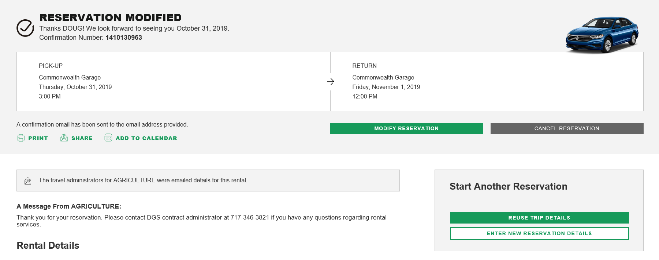
Notes:
Once the modification has been made and saved, you will receive another email confirmation of your reservation. As you can see, the pick up time is now 3:00 PM.

Slide 29
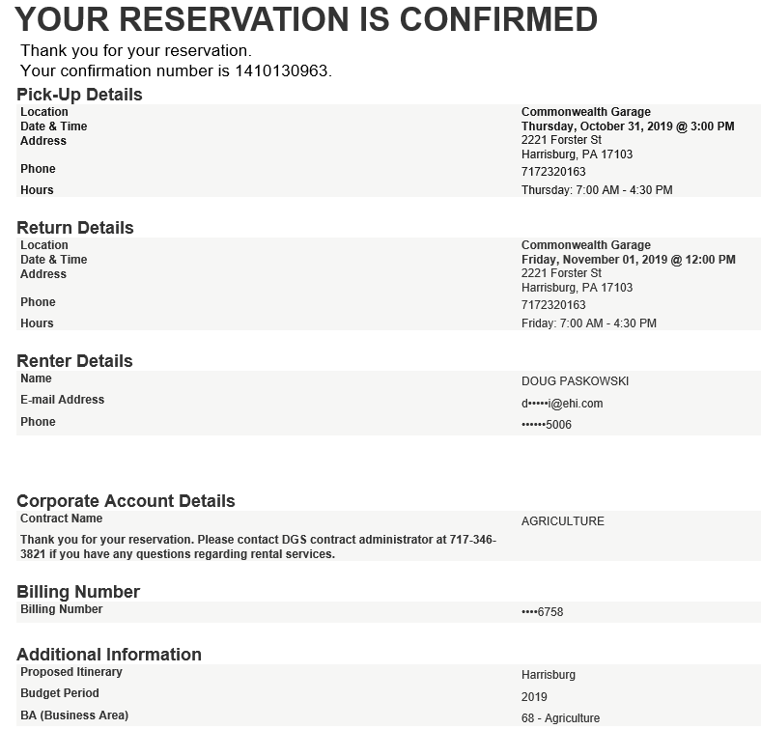
Notes:
You will receive another email confirmation of your reservation if you make a change.

Slide 30
Notes:
If you need to cancel the reservation, click on Modify or Cancel Existing Reservation.

Slide 31
Notes:
Click on Cancel Reservation.

Slide 32
Notes:
You will be asked to confirm your cancellation.

Slide 33
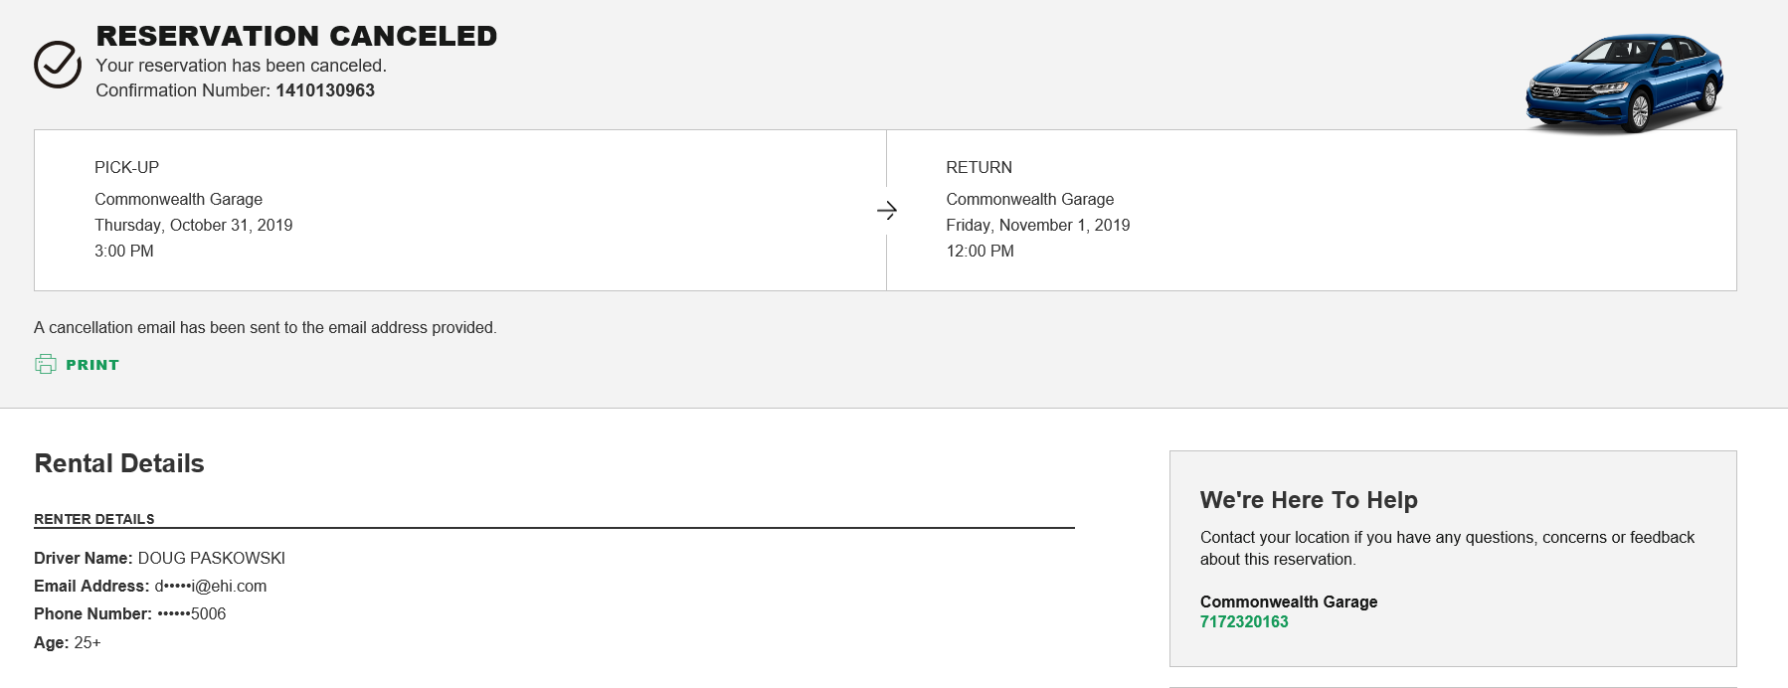
Notes:
After clicking on Cancel Reservation, you will receive this screen indicating the reservation has been cancelled.

Slide 34
Notes:
You will also receive an email confirmation that the reservation has been cancelled.

Slide 35
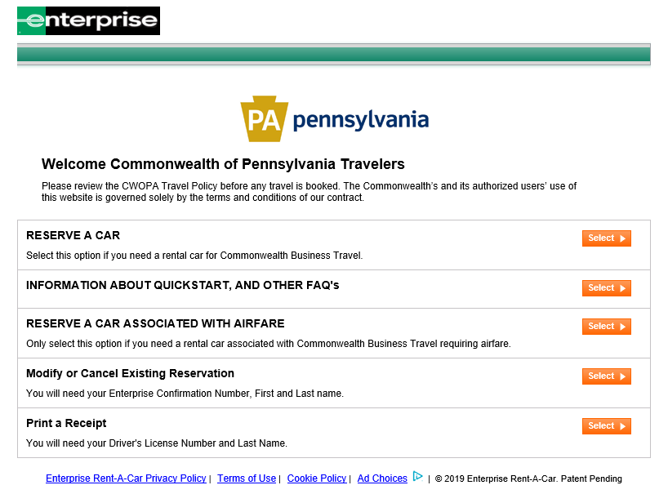
Notes:
If you are in need of a receipt, select Print a Receipt.

Slide 36
Notes:
You will be required to enter your last name as well as driver’s license number to access your receipt. Click Search after entering your information.

Slide 37
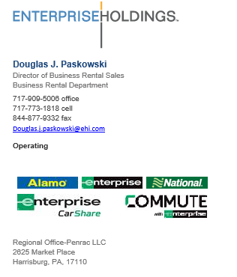
Notes:
Doug Paskowski is the Commonwealth’s Enterprise contact. However, prior to reaching out to Mr. Paskowski, travelers should first direct all questions/concerns through their own agency Automotive Liaison. If your agency Automotive Liaison cannot answer traveler questions/concerns, please contact 717-346-3821 OR email RA-BVM_RENTAL@PA.GOV.

