Slide 1
How to Complete the Ground Travel Worksheet
Rev. 11/2012

Slide 2
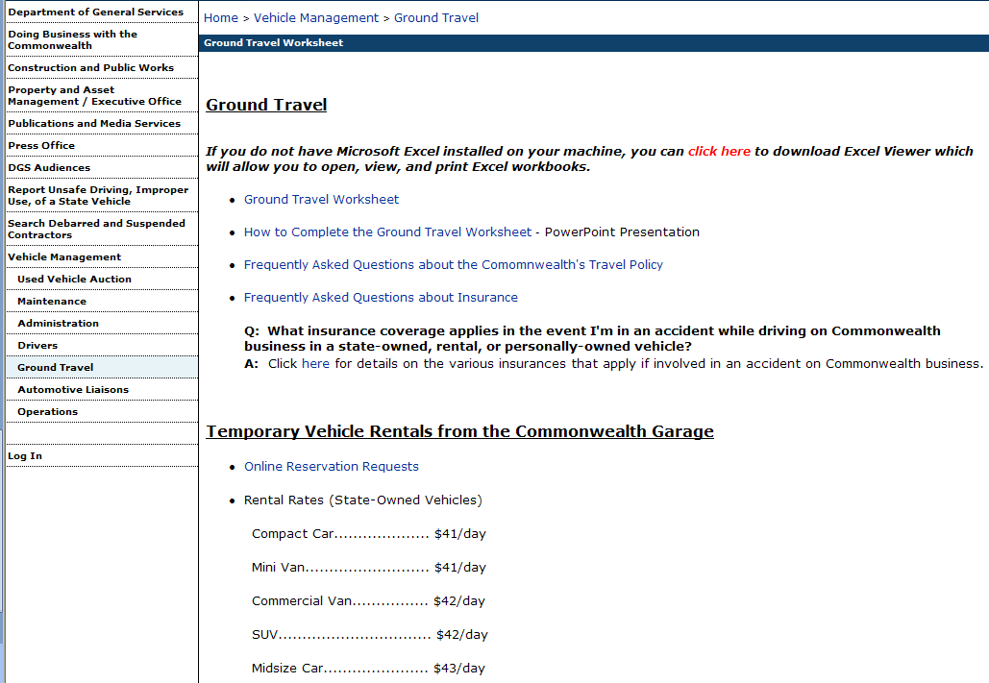
Download the Latest GTW
Always download the most current version of the Ground Travel Worksheet (GTW) as published on BVM’s website (www.dgs.state.pa.us) since fuel rates change weekly.
1. Click on
Vehicle Management
2. Click on
Ground Travel
3. Click on
Ground Travel Worksheet

Slide 3
Download the Latest GTW
After clicking the link to the most current version of the Ground Travel Worksheet (GTW), click Open.

Slide 4
Review the General Information
Take time to review the general information section to better understand calculation rates.
Take note that the GTW does not pertain to travelers who are assigned Commonwealth-owned vehicles or travelers who are willing accept the lower GSA rate of $0.23/mile.

Slide 5
FAQ #1
Do people who have permanently-assigned state-owned vehicles have to do the ground travel worksheet that figures out the most cost effective mode of travel?
No. The ground travel worksheet is intended to provide alternatives to those individuals who do not have a permanently-assigned vehicle and who do not travel frequently for business.

Slide 6
FAQ #2
Do people who wish to use a privately-owned vehicle and receive the lower GSA rate have to do the ground travel worksheet that figures out the most cost effective mode of travel?
No. But the ground travel worksheet is advisable for personal vehicle use if an employee is seeking reimbursement at the standard GSA rate in order to show such usage is the least costly option.

Slide 7
Enter Your Trip Information
No more than 1 month prior to your travel, complete the GTW by entering your specific trip information to determine the most cost-effective mode of ground travel.
The spreadsheet is initially populated with generic data. Replace this data with your information.
The Ground Travel Worksheet should only be utilized for trips that do not exceed 5 days of travel. For “Step 2”, select the number of days from the drop down menu to accommodate your trip.

Slide 8
Enter Your Trip Information
No more than 1 month prior to your travel, complete the GTW by entering your specific trip information to determine the most cost-effective mode of ground travel.
If the employee will be on 6 or more days of travel status, they must proceed to the Weekly & Monthly Rental Rates tab to calculate their trip costs.
If you attempt to enter any amount of days greater than 5 in the total number field, you will receive the error:

Slide 9
Enter Your Trip Information
No more than 1 month prior to your travel, complete the GTW by entering your specific trip information to determine the most cost-effective mode of ground travel.
The current fuel price is based on regular gas prices for Pennsylvania as published on AAA’s Daily Fuel Gauge Report. This price is updated the first business day of each week. Therefore, be sure to use the latest published GTW.

Slide 10
FAQ #3
Am I required to complete the ground travel worksheet for every day that I travel to the field work site?
It is not required, but whether its use is advisable depends on the variables of the particular trip. The supervisor and the employee should evaluate the circumstances and decide the least expensive mode of transportation in advance of the particular trip, whether it is a one-day trip or a multiple day trip. The DGS Ground Travel Worksheet is the recommended tool that can be used in making that determination and is recommended to be submitted with the expense report to show the auditor the methodology used in making the determination ONLY IF the traveler is requesting the higher GSA rate for reimbursement of personal miles.

Slide 11
FAQ #4
When using the ground travel worksheet to assist in calculating the least expensive mode of transportation, does the traveler use mileage from their home or from their headquarters?
Use the reimbursable number of miles. If leaving from their residence, travelers should use the shorter of residence to work site OR headquarters to work site.

Slide 12
Review the Ground Travel Options
Once you have entered your trip information, the GTW will automatically calculate and rank the various options from least expensive to most expensive.
This is the standard GSA rate

Slide 13
Traveling by Personal Auto
If you prefer to travel by personal auto, you may. However, if “Personal Auto – Standard Rate” is not the best value, then you will typically be reimbursed at the lower GSA rate.
This is the lower GSA rate

Slide 14
More Details on Your Options
If certain options will not work in your particular situation, be sure to have your supervisor notate these options on the bottom of the form.
For instance, if your agency does not have pool vehicles, then the “Agency Pool Vehicle” option would not apply to you.

Slide 15
Up-charges to Enterprise Rent-A-Car
The Enterprise Rent-A-Car rate is based on rental of a compact car.
The General Information tab lists potential up-charges to this rate. These up-charges must be calculated manually and entered on the form in order to figure out the final costs and ranking of the travel options.

Slide 16
Weekly and Monthly Rental Rates
Depending on the specifics of your travel, your most cost effective mode of travel may be to engage in a long-term rental. The 3rd tab of the GTW shows current weekly and monthly rental charges. Below are examples of one of the weekly rental rates and one of the monthly rental rates.
You should consider a long-term rental if you are traveling more than the estimated breakeven miles:
-- Per week
OR
-- Per month

Slide 17
Enter Your Information
Enter your information in all areas highlighted below.

Slide 18
Supervisor Signature
Your supervisor must sign and approve this form any time a mode of ground transportation is chosen that is not the least expensive option. The supervisor must indicate the basis and justification for his/her decision to approve the more expensive mode of travel.
If you have
any up-charges from tab 1, explain them in the supervisor’s comments box.
Personal mileage to pick up vehicle = 10 miles x .555 = $5.55
Enterprise Rent-A-Car total = $92.87
Up-charge to Intermediate or Standard Size:
$92.87 + $2.00 x 2 days ($4.00) = $96.87

Slide 19
FAQ #5
How much discretion does a supervisor have in determining that a mode of transportation that is less expensive than privately-owned vehicle use is inefficient and warrants use of the privately-owned vehicle?
Supervisors are responsible to make that decision consistent with operational/business needs. However, decisions must be based on legitimate operational/business needs, and failure by the supervisor to exercise care in the review and approval of travel expenses may result in disciplinary action.

Slide 20
What To Do Once the GTW is Complete
If the traveler is not selecting the least expensive mode of travel, they should retain a hard copy of the GTW that is signed and dated by the supervisor for his/her records.
If the traveler is requesting the higher GSA rate for reimbursement of personal mileage, then the GTW should be submitted along with the travel expense report to show the auditor the methodology used in making the determination.

